Slide 1
Logistic Regression Case Study
Data analytics approach
Sreya Basak

Slide 2
Agenda
Introduction
Data Exploration
Model Development
Interpretation

Slide 3
Introduction
Case: Credit Card Default
We would like to be able to predict customers that are likely to default
The Y variable (Default) is categorical: Yes or No
How do we check the relationship between Y and X?

Slide 4
Introduction
Why not Linear Regression?
The regression line ßo+ß₁X can take on any value between negative and positive infinity.
In the Credit Default classification problem, Y can only take on two possible values: 0 or 1..
Therefore the regression line often predicts the wrong value for Y in classification problems

Slide 5
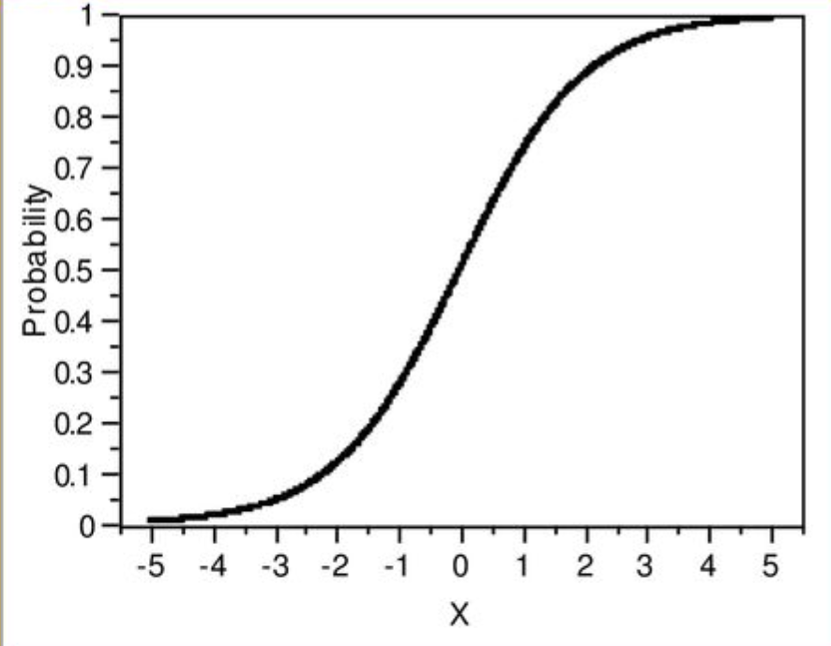
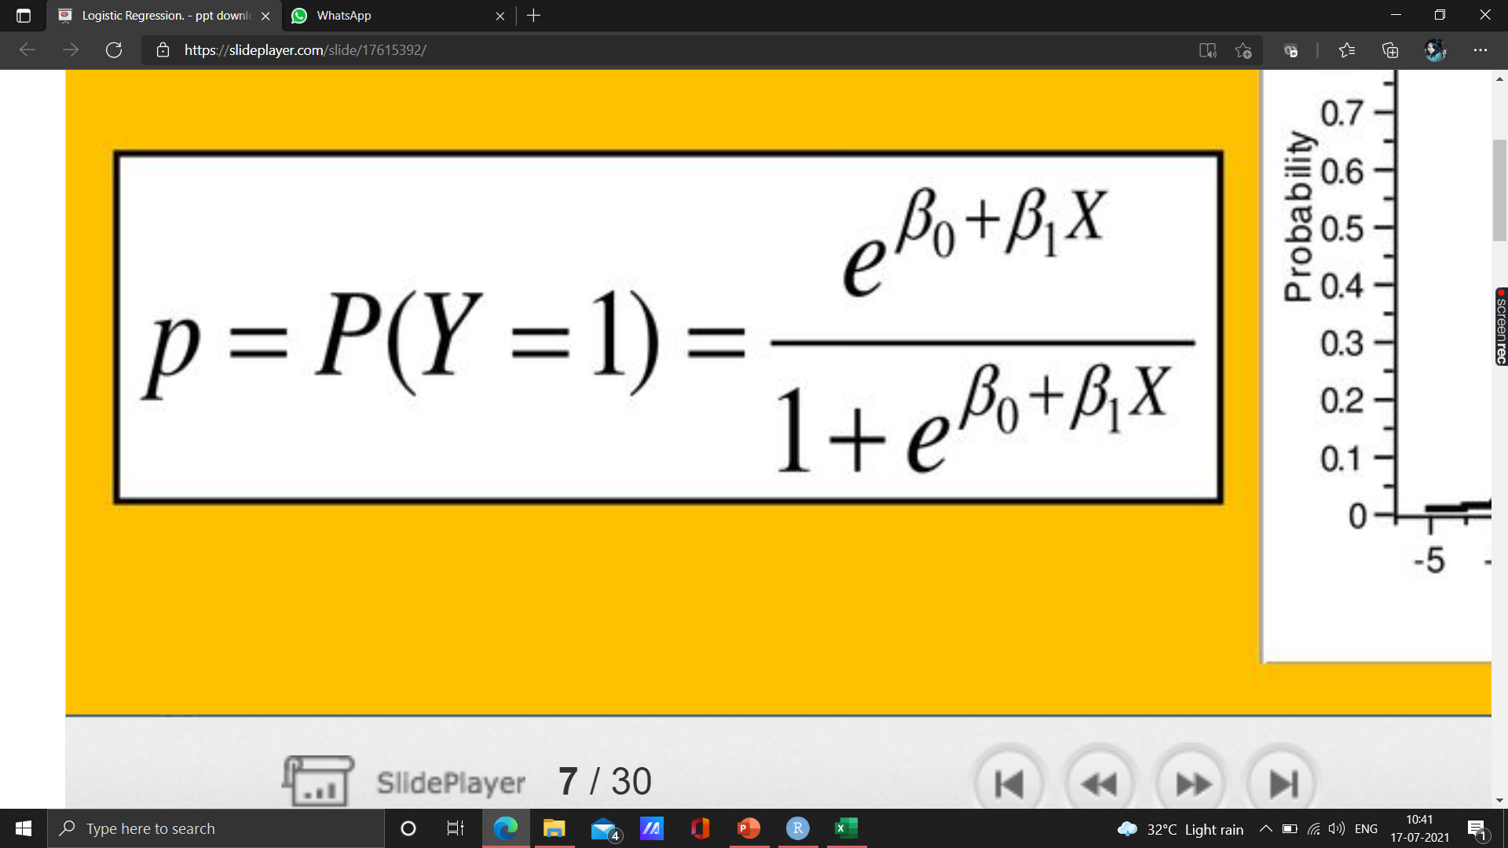
Introduction
Solution: Use Logistic Function.
Instead of trying to predict Y, let's try to predict P(Y= 1), i.e., the probability a customer Defaults.
We could model P(Y = 1) using a function that gives outputs between 0 and 1..
We can use the logistic function :
Logistic Regression!

Slide 6
Introduction
Identifying the key variables which significantly explains the probability of ‘Default_On_Payment’
Approach Required: Business & Analytical Solution which takes into account the business context.
Data treatment: Missing Values Treatment
Data Exploration
Splitting the data into train and test data
Model Building and Refinement: Train and Test Data
Hypothesis formulation: hypothesis of independent variable w.r.t dependent variable
Business Context of the problem:
‘The client, a financial service institution, want to increase revenue streams and intents to target a segment of their customers who are most likely to default on the loans/Credit taken.’

Slide 7
Data Exploration
Data Quality Assessment and Clean Up
Summary Table
 | Accuracy | Completeness | Consistency | Currency | Relevancy | Validity
Data_for_ Logistic_ Regression |  | No missing value
The dataset consist of 5000 observations of 23 variables.
No. of numerical variable : 9
No. of Categorical variable: 14

Slide 8
Data Exploration
Data insights from the given dataset :
Numerical
Most of the customers have taken the loan from the financial service institution for an average of 21 months i.e. 2 years.
An average credit amount of 3271 has been taken by most of the customers though the highest credit amount is 18424.
Most of the customers lie in the group of 29-38 years and have a mean age of 35 years. Age group of 69-78 has the lowest no. of customers.

Slide 9
Data Exploration
Summary for the Categorical Variable
Status_Checking_Acc | Duration_in_Months | Credit_History | Purposre_Credit_Taken | Credit_Amount | Savings_Acc
A11:1370 | Min. : 4.0 | A30: 200 | A43 :1400 | Min. : 250 | A61:3015
A12:1345 | 1st Qu.:12.0 | A31: 245 | A40 :1170 | 1st Qu.: 1366 | A62: 515
A13: 315 | Median :18.0 | A32:2650 | A42 : 905 | Median : 2320 | A63: 315
A14:1970 | Mean :20.9 | A33: 440 | A41 : 515 | Mean : 3271 | A64: 240
 | 3rd Qu.:24.0 | A34:1465 | A49 : 485 | 3rd Qu.: 3972 | A65: 915
 | Max. :72.0 |  | A46 : 250 | Max. :18424
 |  |  | (Other): 275
Years_At_Present_Employment | Inst_Rt_Income | Marital_Status_Gender | Other_Debtors_Guarantors | Current_Address_Yrs
A71: 310 | 1: 680 | A91: 250 | A101:4535 | 1: 650
A72: 860 | 2: 1155 | A92:1550 | A102: 205 | 2: 1540
A73:1695 | 3: 785 | A93:2740 | A103: 260 | 3: 745
A74: 870 | 4: 2380 | A94: 460 |  | 4: 2065
A75:1265

Slide 10
Data Exploration
Summary for the Categorical Variable
Property | Other_Inst_Plans | Housing | Job | Telephone | Foreign_Worker
A121:1410 | A141: 695 | A151: 895 | A171: 110 | A191:2980 | A201:4815
A122:1160 | A142: 235 | A152:3565 | A172:1000 | A192:2020 | A202: 185
A123:1660 | A143:4070 | A153: 540 | A173:3150
A124: 770 |  |  | A174: 740
Here, our dependent variable is the Default_on_Payment which has the following stat:
No. of persons not likely to default are 3505
No. of persons who are likely to default are 1495

Slide 11
Data Exploration
Information value for the Numerical and Categorical Variable
S.No | Variable Name | IV
1 | Customer_ID | 0.019188921
2 | Duration_in_Months | 0.23846948
3 | Credit_Amount | 0.110607157
4 | Inst_Rt_Income | 0.027941771
5 | Current_Address_Yrs | 0.002976114
6 | Age | 0.096781571
7 | Num_CC | 0.010738813
8 | Dependents | 2.07E-05
9 | Count | 0
10 | Status_Checking_Acc | 0.662862637
11 | Credit_History | 0.292735469
12 | Purposre_Credit_Taken | 0.173555983
13 | Savings_Acc | 0.19363296
14 | Years_At_Present_Employment | 0.086258015
15 | Marital_Status_Gender | 0.042557444
16 | Other_Debtors_Guarantors | 0.032057621
17 | Property | 0.117522541
18 | Other_Inst_Plans | 0.058855966
19 | Housing | 0.085287467
20 | Job | 0.009003153
21 | Telephone | 0.005784725
22 | Foreign_Worker | 0.043567743
According to Siddiqi (2006), by convention the values of the IV statistic can be interpreted as follows.
If the IV statistic is:
Less than 0.02, then the predicter is not useful for modeling (separating the Goods from the Bads)
0.02 to 0.1, then the predictor has only a weak relationship to the Goods/Bads odds ratio
0.1 to 0.3, then the predictor has a medium strength relationship to the Goods/Bads odds ratio
0.3 or higher, then the predictor has a strong relationship to the Goods/Bads odds ratio.

Slide 12
Model Development
Logistic Regression : Methodology
Maximum Likelihood Estimation Technique
Estimation of parameters in logistic regression is carried out using Maximum Likelihood Estimation (MLE) technique.
MLE is a statistical model for estimating model parameters of a function.
For a given dataset, the MLE chooses the values of model parameters that makes the data "more likely", than other parameter values.

Slide 13
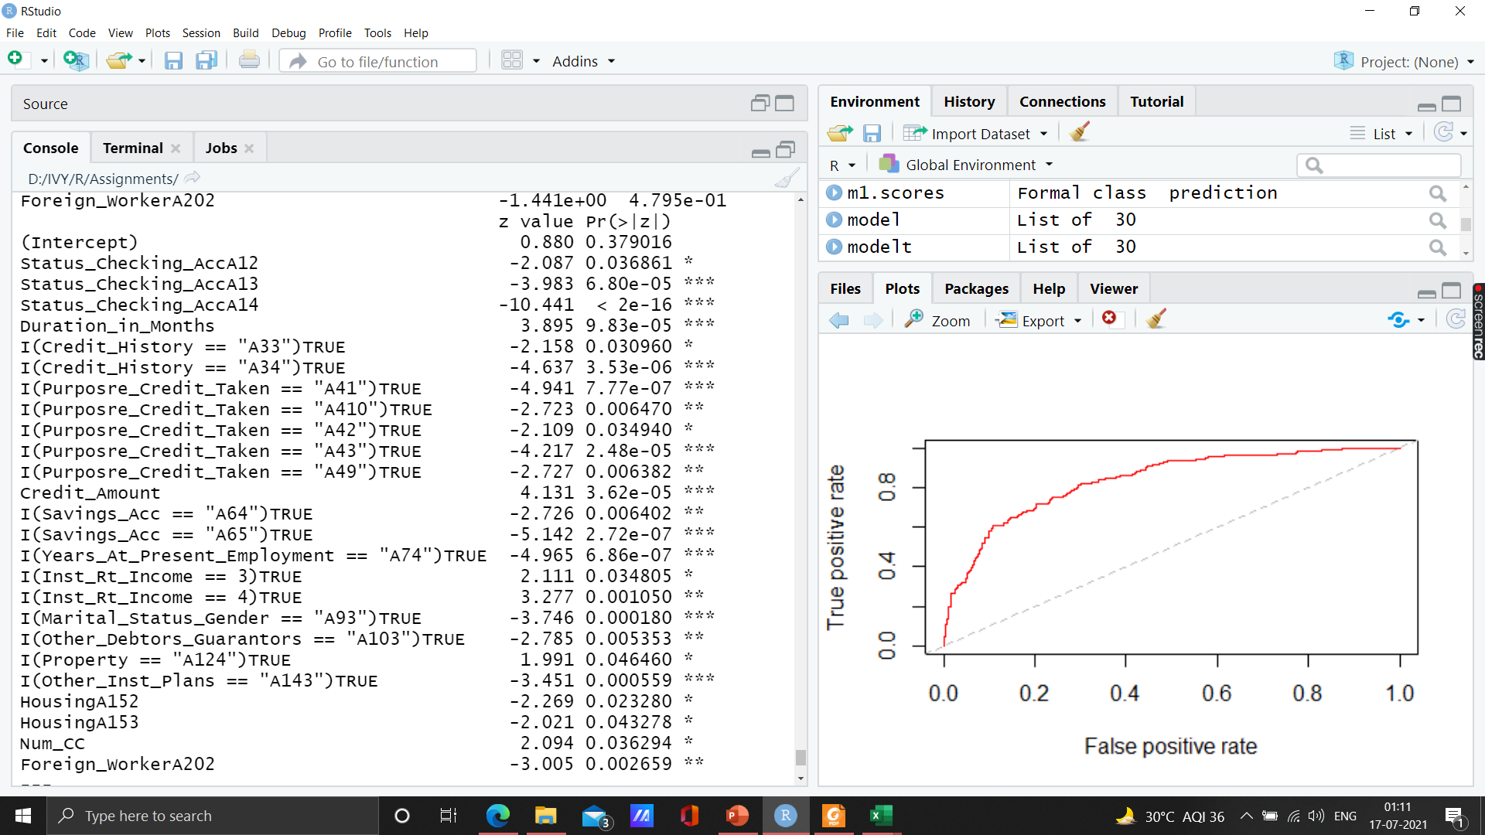
Model Development
Logistic Regression Model Building
The dataset is split into 70% training dataset and 30% test dataset.
Then we will be removing the insignificant variable based on high p-value from the training dataset one by one to build our training model.
Finally after removing the insignificant variables from the training model we have the following 26 significant variables in our evaluation model.

Slide 14
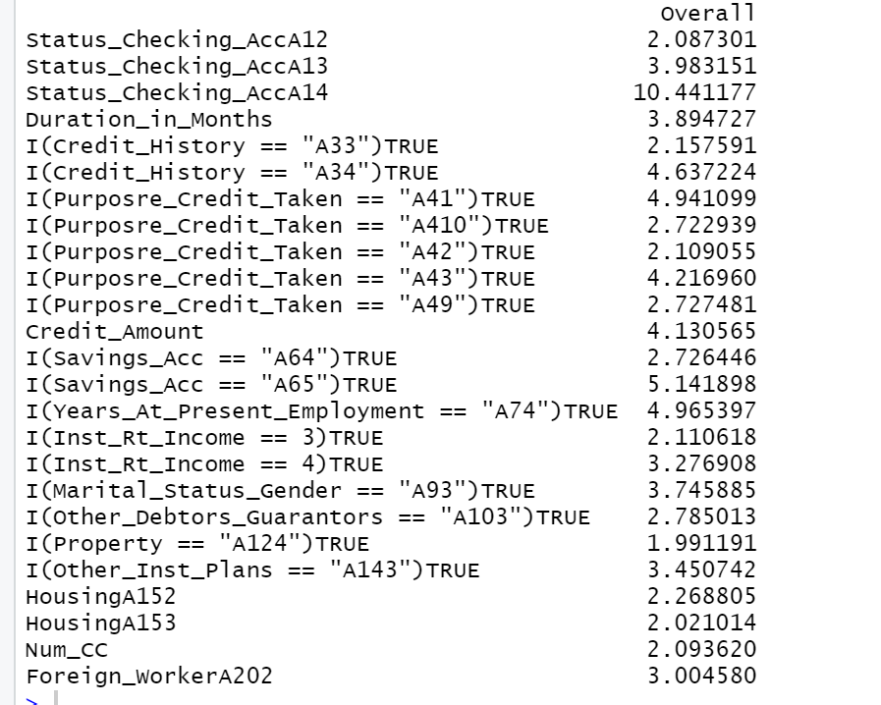
Model Development
Logistic Regression Model Building
Variable Importance
The following image shows the importance of variables in the evaluation dataset.
Status_Checking_AccA14 is the variable with highest overall importance 10.441177 followed by Savings_Acc A65 with importance of 5.141898.
Variable with lowest importance value of 1.99 is Property A124.

Slide 15
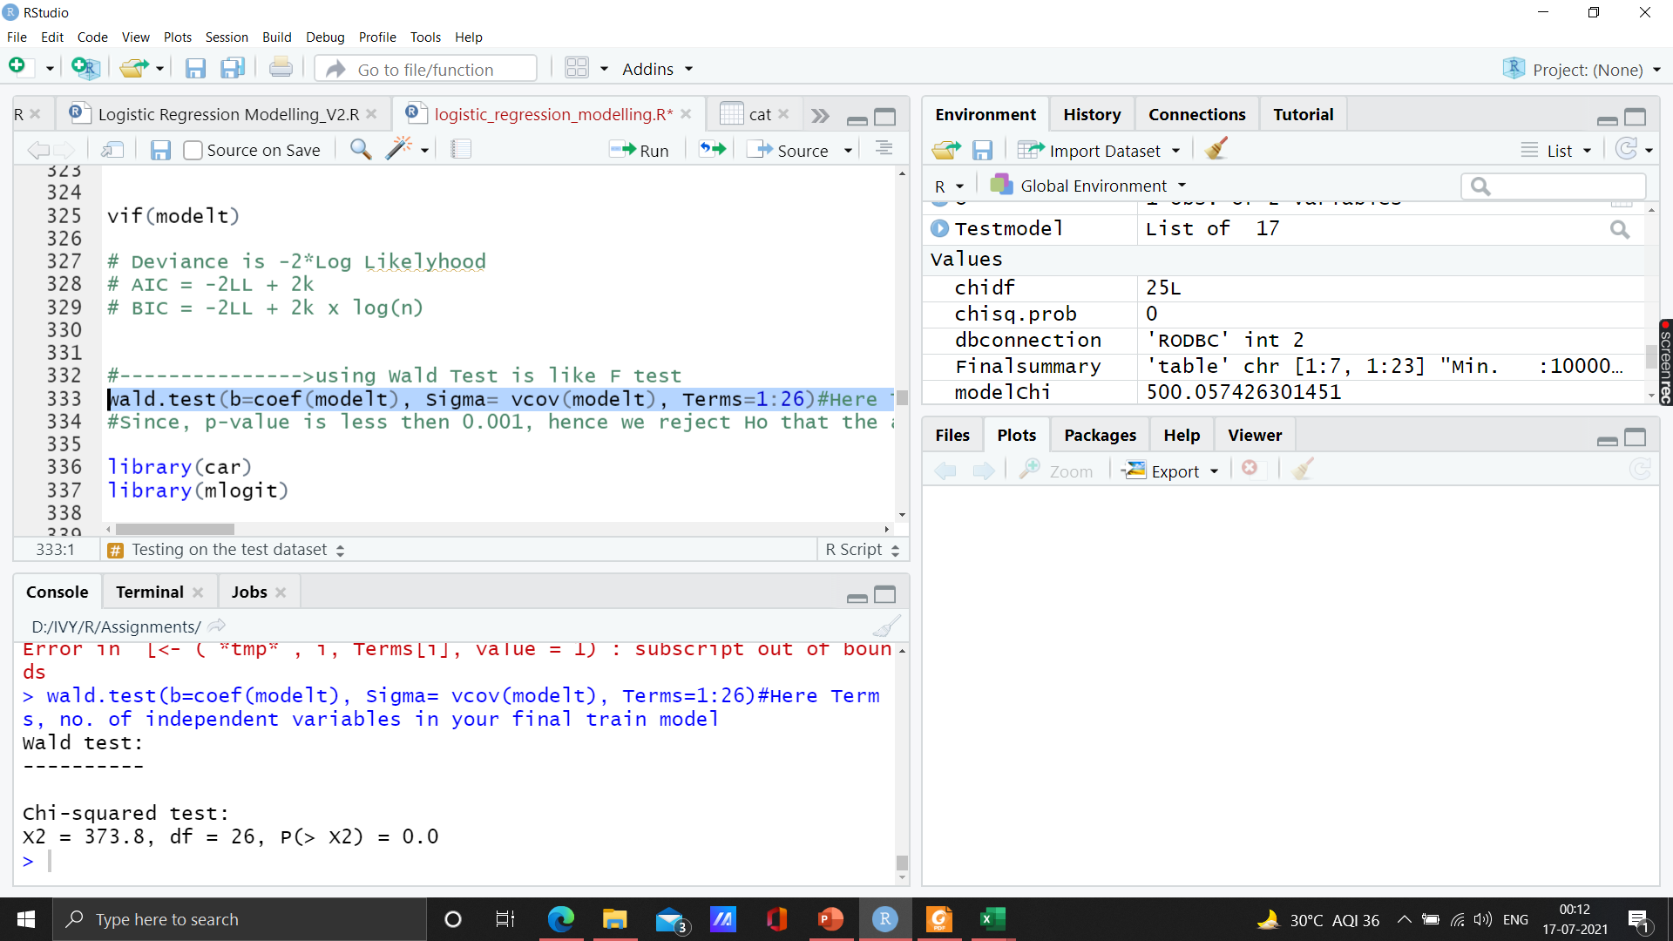
Interpretation
Logistic Regression: Inference and Diagnostics
Wald Test
Wald Test is used to check the significance of individual explanatory variables in Logistic Regression (similar to t-statistic in linear regression)
Wald Test statistic is a chi-square test statistic
Null Hypothesis Ho: Bi=0
Alternative Hypothesis H1: Bi≠0
Since, p-value is less then 0.001, hence we reject Ho that the all Bi=0.

Slide 16
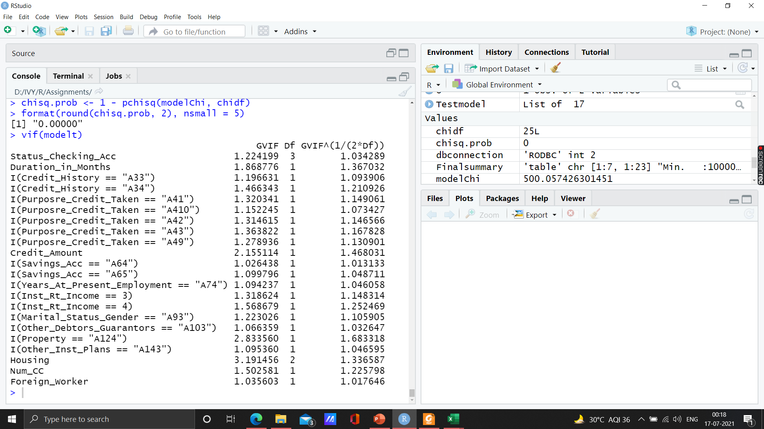
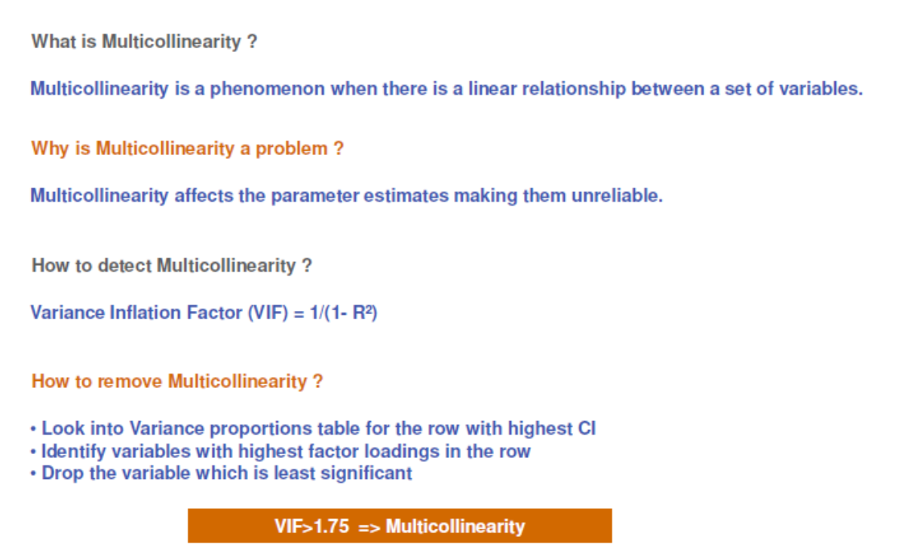
Interpretation
Logistic Regression: Inference and Diagnostics
Variance Inflation Factor
The model does not suffer from multicollinearity as all the values are less than 1.7
The model does not suffer from multicollinearity as all the values are less than 1.7

Slide 17
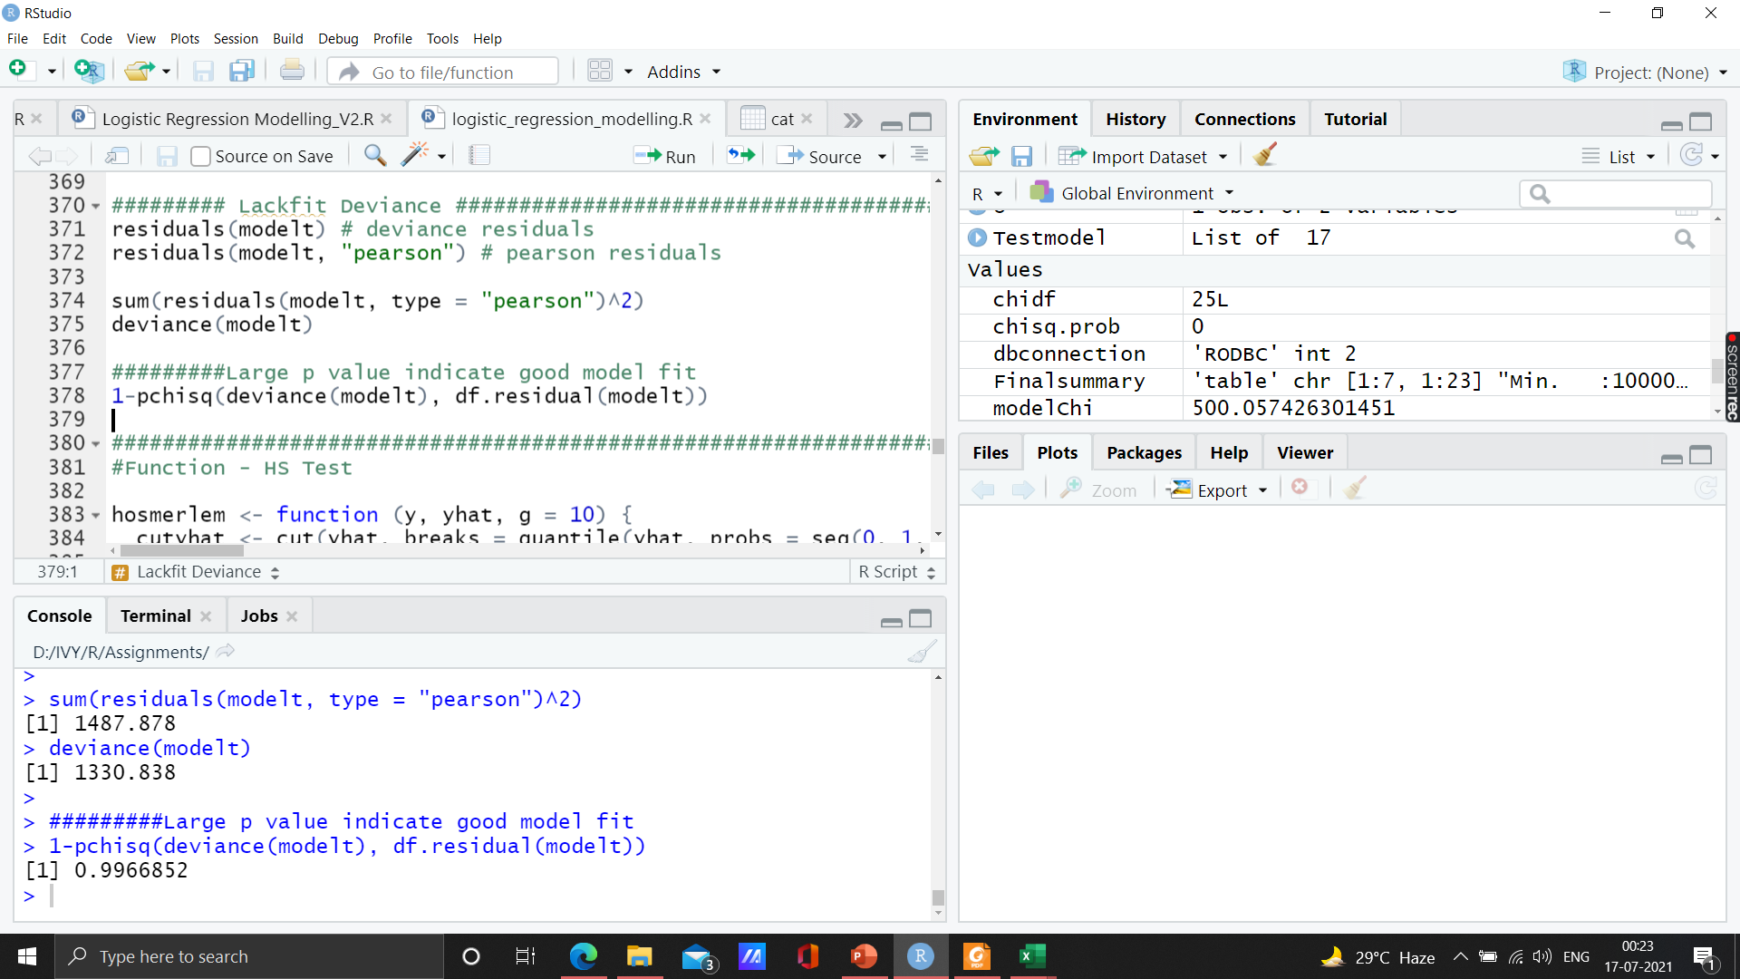
Interpretation
Logistic Regression: Inference and Diagnostics
Lackfit Deviance Test
Lackfit Deviance for assessing whether the model where
Ho: Observed Frequencies/probabilties =Expected Frequencies/probabilities
Larger p-value indicate good model fit
Thus, we accept the Null Hypothesis Ho that Observed Frequencies = Expected Frequencies

Slide 18
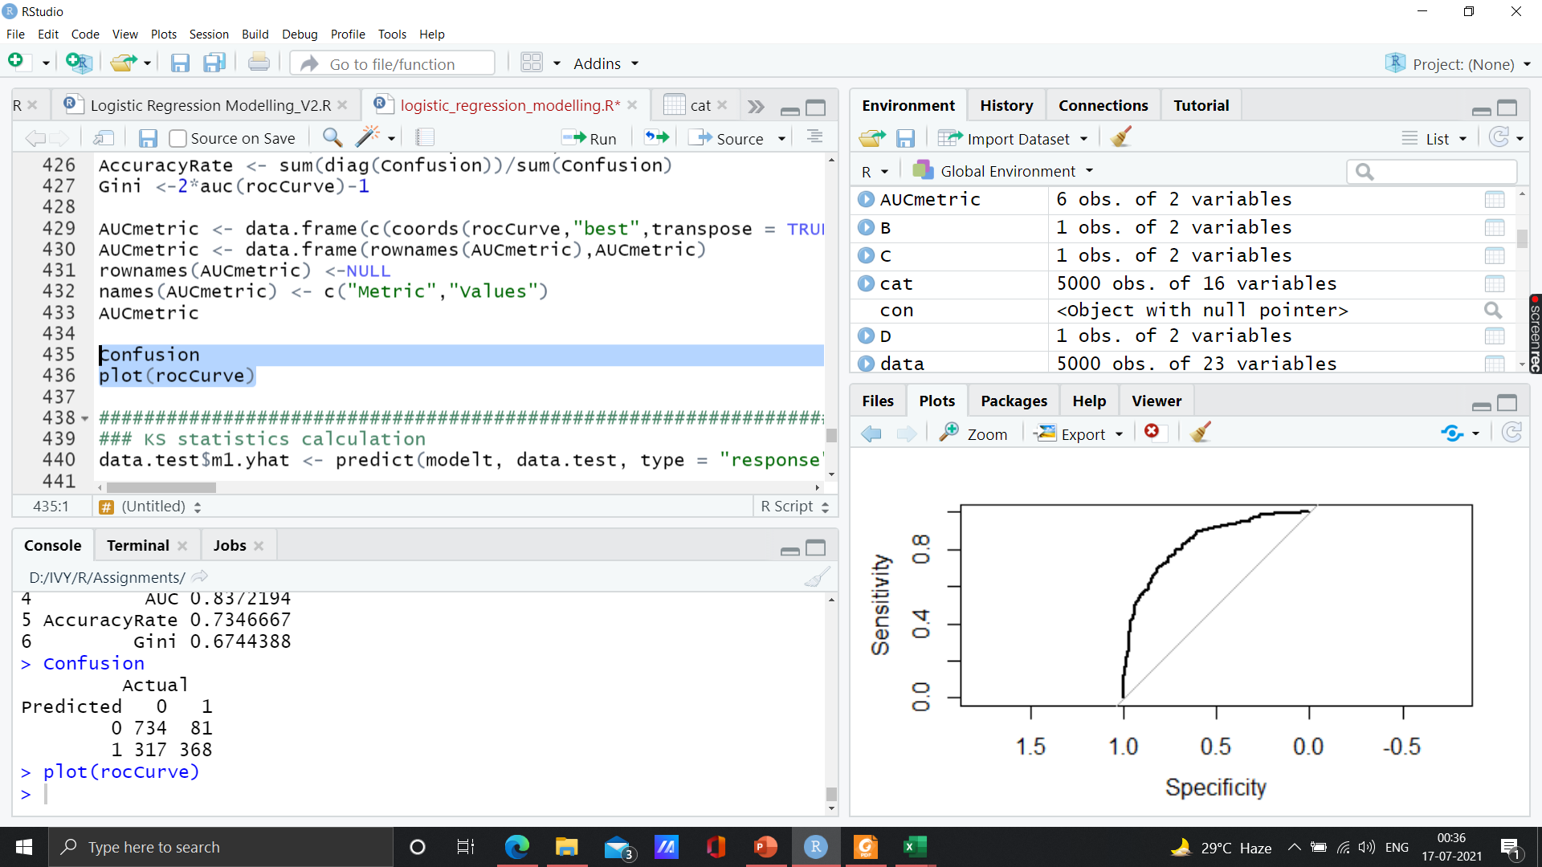
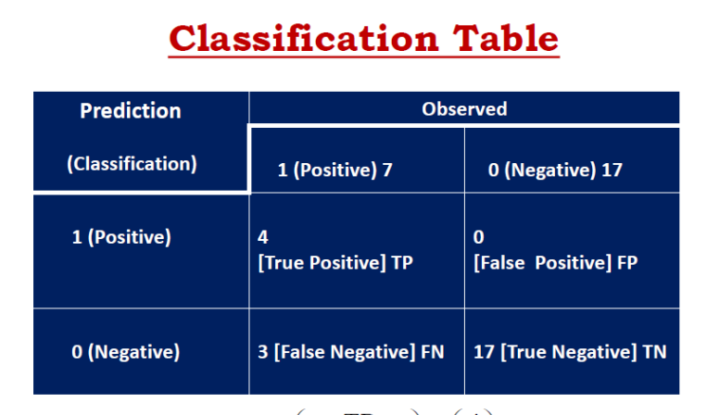
Interpretation
Logistic Regression: Inference and Diagnostics
Confusion Matrix
Confusion matrix is a tabulation of the predicted and actual value counts for each possible class. For a binary classification model like this one, where you're predicting one of two possible values, the confusion matrix is a 2x2 grid showing the predicted and actual value counts for classes 0 and 1, similar to this:
True negative: 734
False negative: 81
True Positive: 368
False positive: 317

Slide 19
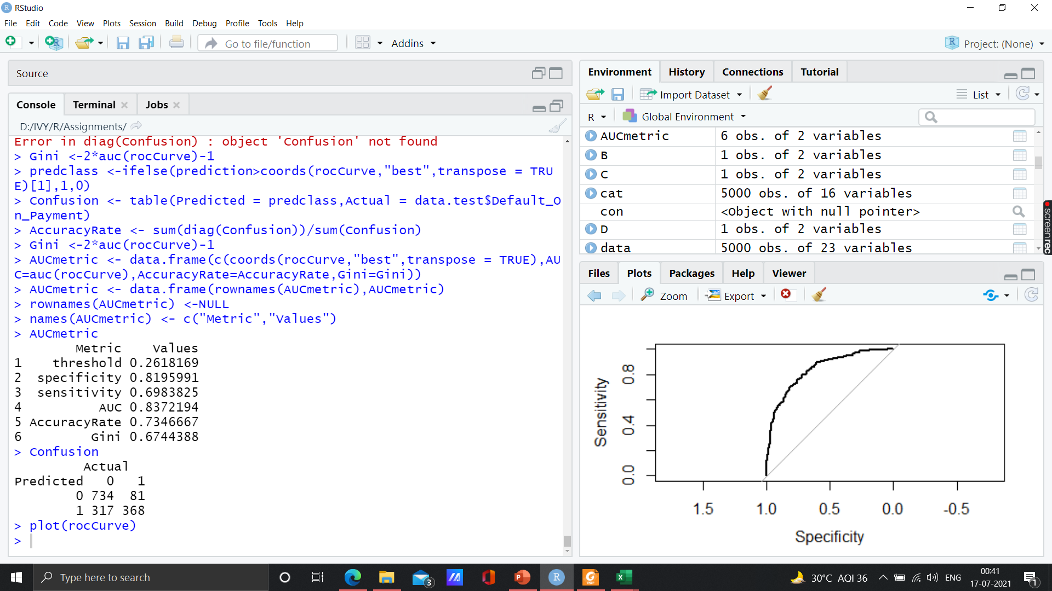
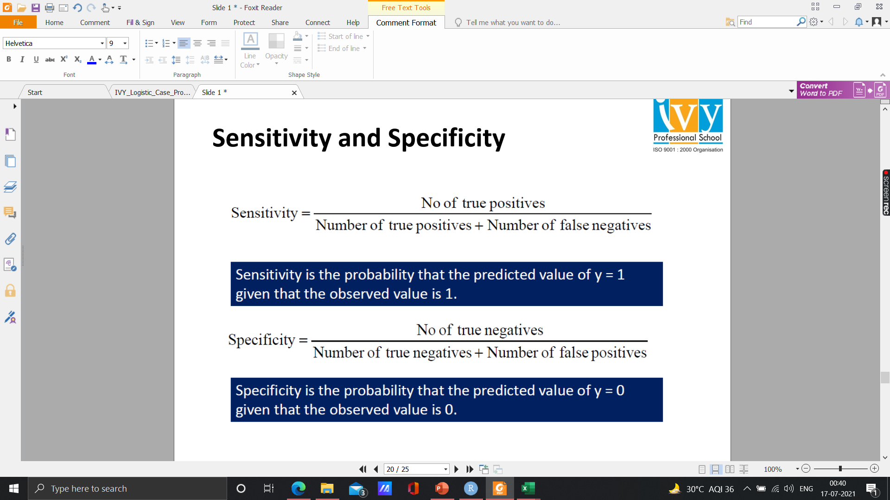
Interpretation
Logistic Regression: Inference and Diagnostics
Sensitivity and Specificity
True negative: 734
False negative: 81
True Positive: 368
False positive: 317
AUC should be > 0.80 and the desirable range of Gini is 0.4-0.8 which is significant here.
Gini index or Gini impurity measures the degree or probability of a particular variable being wrongly classified when it is randomly chosen

Slide 20
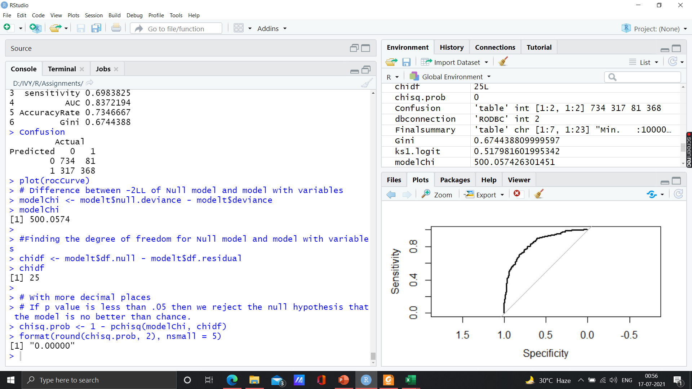
Interpretation
Logistic Regression: Inference and Diagnostics
Lagrange Multiplier or Score Test
Lagrange Multiplier or Score Test (Assess whether the current variable significantly improves the model fit or not).
Null Hypothesis: Null model = Baseline Model
Alternate Hypothesis: Null model <> Baseline Model
Null model will explain the 'y' less and actual model will explain the 'y' more
If p-value is less than 0.05 then we reject the null hypothesis that the model is no better than chance.
Here, null hypothesis is rejected as chi square probability is 0.0000 < 0.05

Slide 21
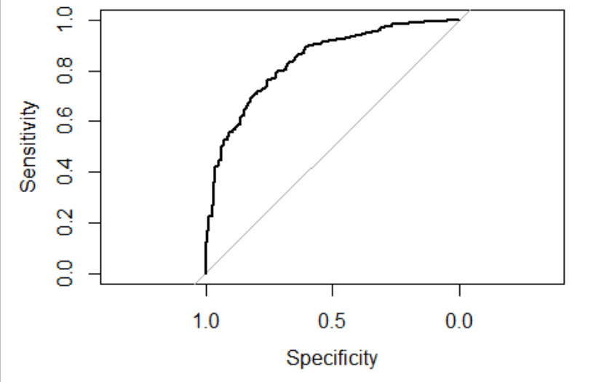
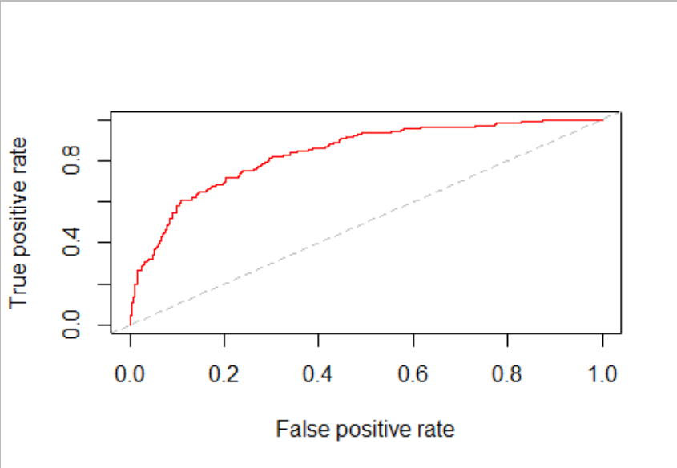
Interpretation
Logistic Regression: Inference and Diagnostics
AUC-ROC Curve
The Receiver Operator Characteristic (ROC) curve is an evaluation metric for binary classification problems. It is a probability curve that plots the TPR against FPR at various threshold values and essentially separates the ‘signal’ from the ‘noise’. The higher the area under ROC curve the better is the prediction ability.
The Area Under the Curve (AUC) is the measure of the ability of a classifier to distinguish between classes and is used as a summary of the ROC curve.
The following graphs show the AUC-ROC curve.
KS- statistics for the model is : 0.5179 which is well between 40-70% significance level.

Slide 22
Interpretation
Business Hypothesis

Slide 23
Note: The data and information in this document is reflective of a hypothetical situation and client. This document is to be used for KPMG Virtual Internship purposes only.
Thank You

